Slide 1






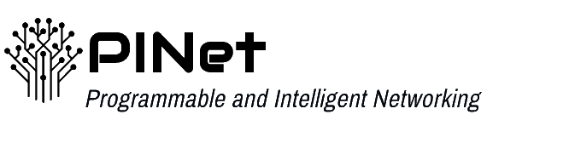





IoT Device Fingerprinting on Commodity Switches
Carson Kuzniar, Miguel Neves, Vladimir Gurevich, Israat Haque
1

Slide 2

IoT Landscape
12.3 billion connected IoT devices ​
Roughly $160 Billion in IoT enterprise spending​
IoT botnet-based DDoS attacks reaching over 1 Tbps
Hundreds of thousands of compromised devices
Above 200K for Mirai botnet
2

Slide 3

IoT Fingerprinting
Critical task for network administrators to
Check for known vulnerabilities
Set access/firewall rules
Configure intrusion detection systems
3

Slide 4
State of the Art
Machine Learning (WiSec’20)
Labeled Traffic from Manufacture/User (NOMS’20)
Length and direction-based signatures (NDSS’20, IM’21)
Solutions face obstacles at scale or with network wide view
Require mirroring traffic to dedicated hardware
4

Slide 5
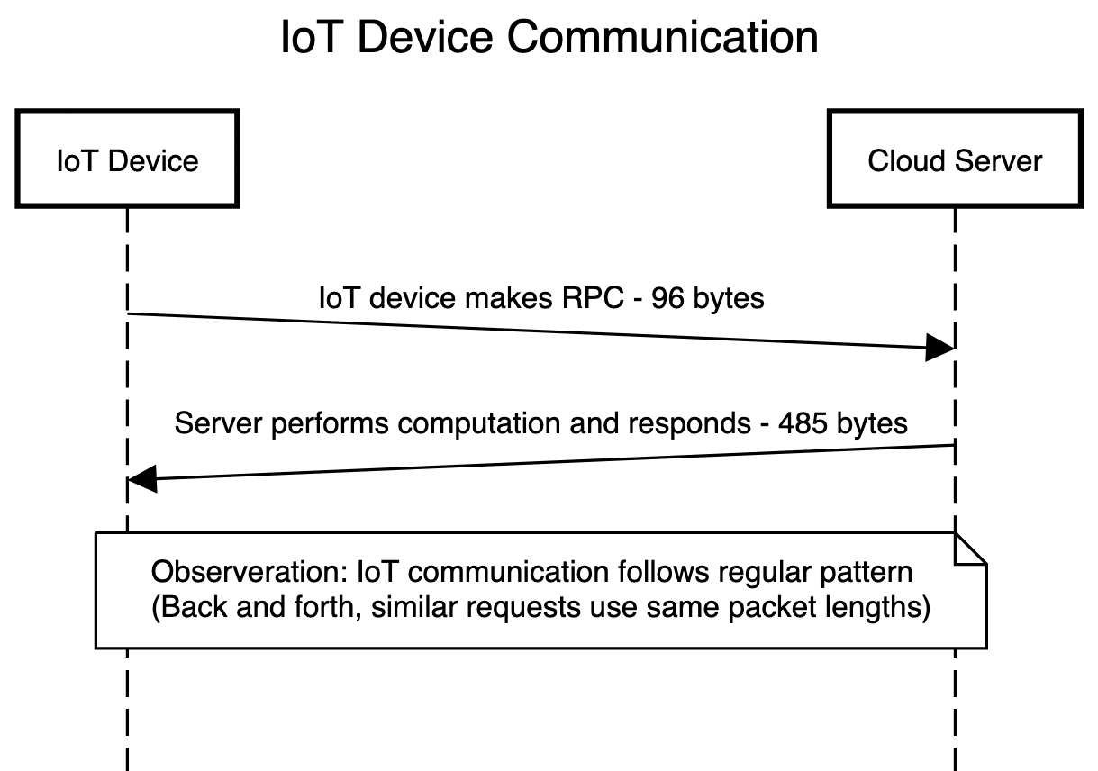
Device Signatures
Use packet length and direction to create signatures for events (e.g., On/Off)
Reliably fingerprint devices using these signatures
R. Trimananda, J. Varmarken, A. Markopoulou, and B. Demsky, “Packet-Level Signatures for Smart Home Devices,” Proceedings of the 2020 Network and Distributed System Security (NDSS) Sympo- sium, February 2020.
5

Slide 6
Challenges
Volume
Large amounts of traffic on high-speed links
Drop accuracy or add significant delay
6

Slide 7
Challenges
Volume
Large amounts of traffic on high-speed links
Drop accuracy or add significant delay
Granularity
Sampling and aggregation miss quiet device
7

Slide 8

Introducing PoirIoT
Programmable Data-Plane based Fingerprinting:
High-speed : Tofino ASIC Line Rate (Tbps)
High granularity: Inspects every packet as part of its forwarding process
Modular : Efficient use of switch resources
8

Slide 9
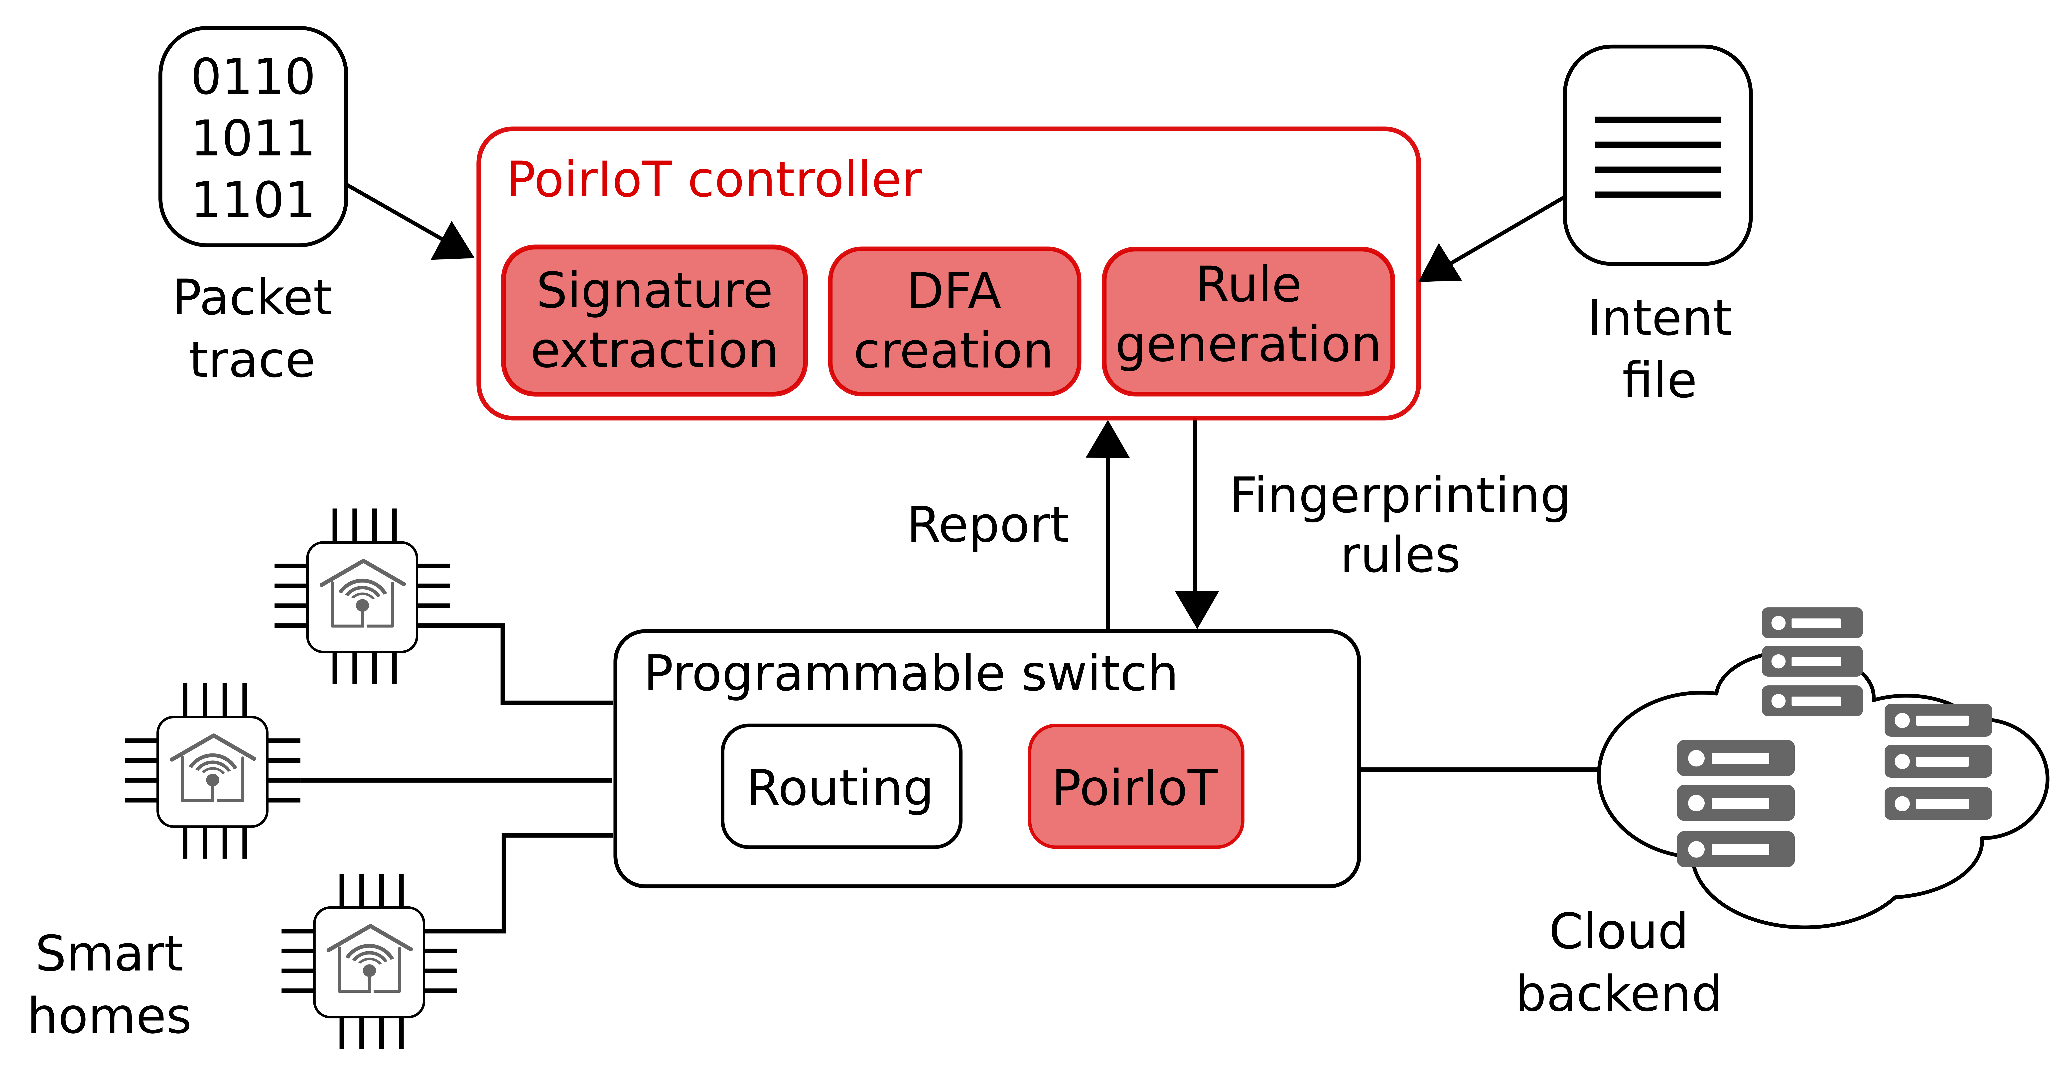
PoirIoT Architecture
9

Slide 10
PoirIoT Architecture
10

Slide 11
Signature Extraction
11

Slide 12
Signature Extraction
12

Slide 13
Signature Extraction
13

Slide 14
Signature Extraction
14

Slide 15
Signature Extraction
15

Slide 16
PoirIoT Architecture
16

Slide 17
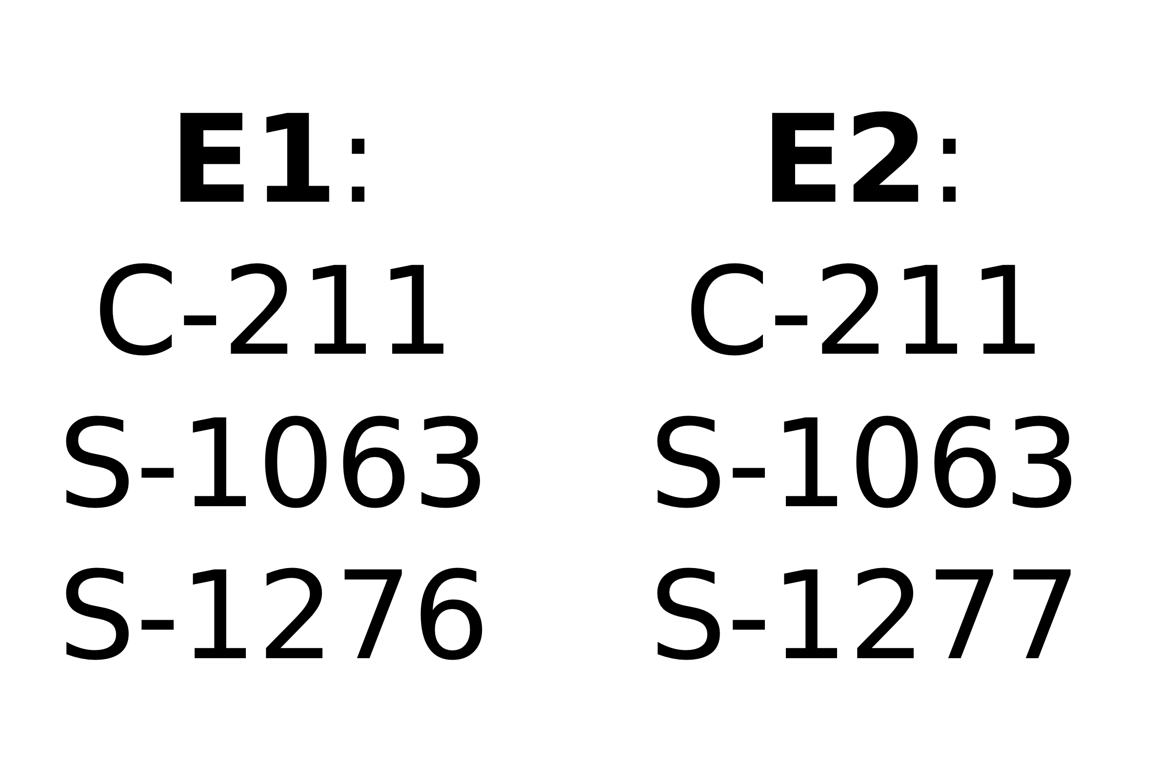
DFA and Rule Creation
17

Slide 18
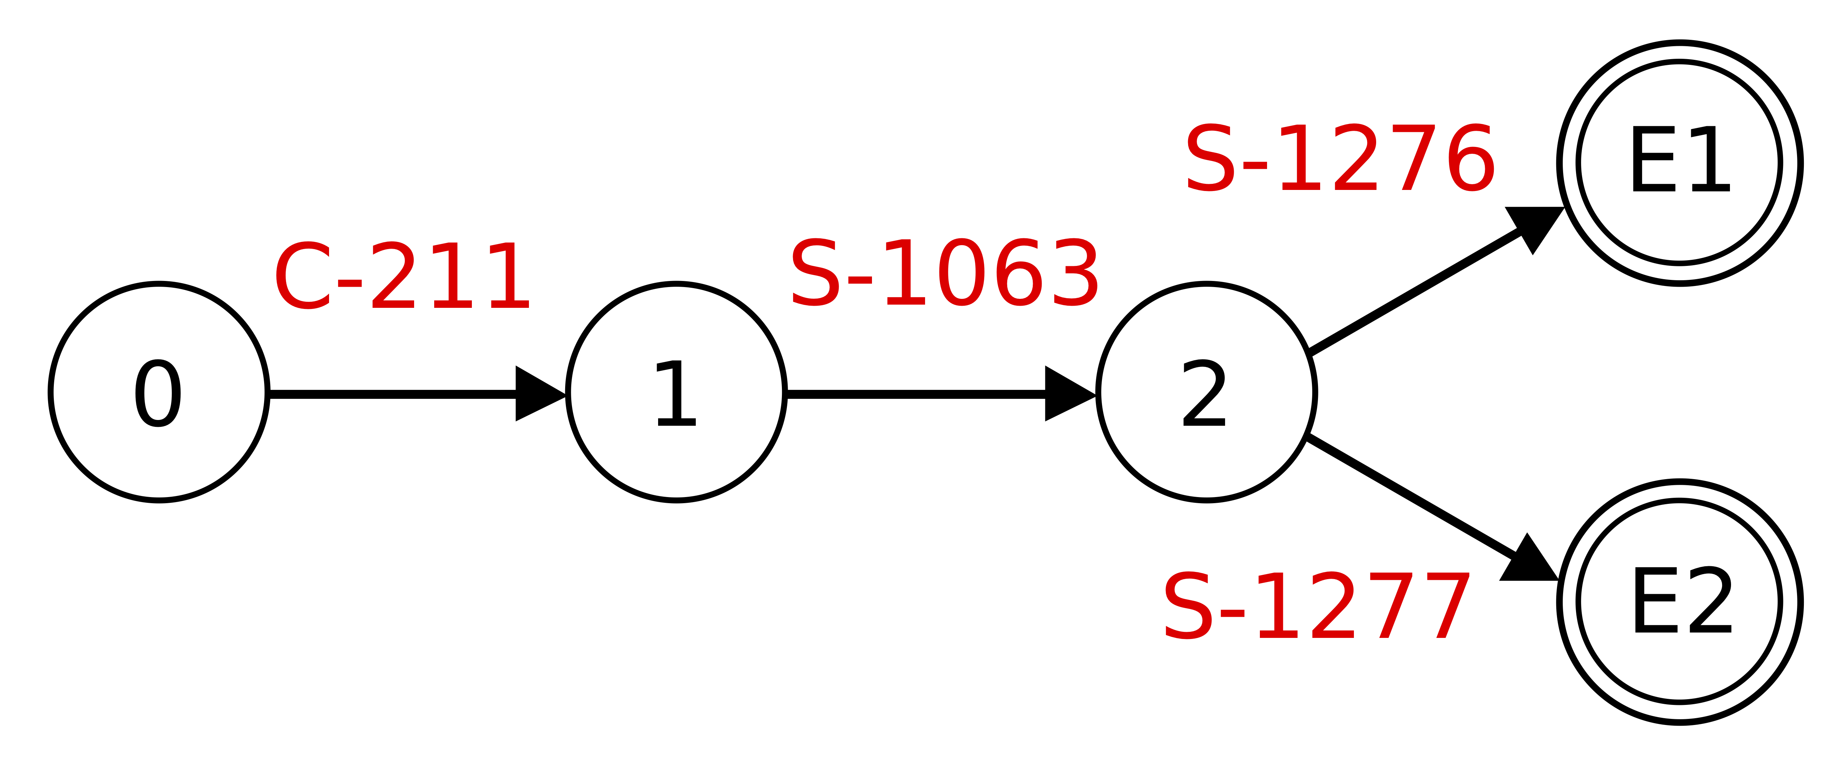
DFA and Rule Creation
18

Slide 19
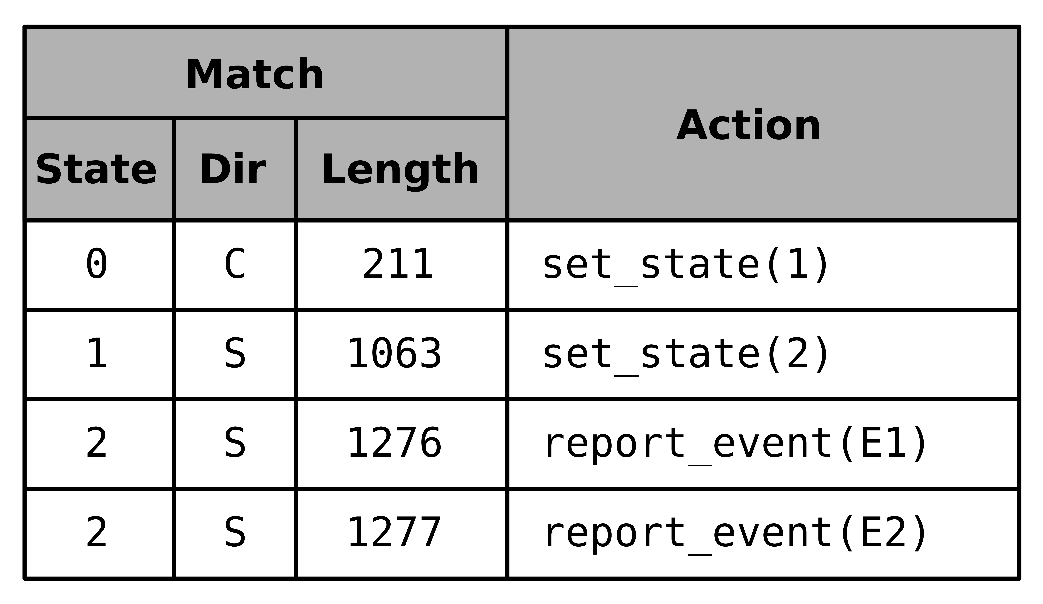
DFA and Rule Creation
19

Slide 20
PoirIoT Architecture
20

Slide 21
PoirIoT Data Plane
21

Slide 22
PoirIoT Data Plane
State and Timer info stored per flow
Virtual FSM per flow while requiring only a single table
22

Slide 23
PoirIoT Data Plane
State and Timer info stored per flow
Virtual FSM per flow while requiring only a single table
23

Slide 24
PoirIoT Data Plane
Length filter prevents resource allocation to flows with no packets of interest
24

Slide 25
PoirIoT Data Plane
Resubmit used instead of recirculation to update information without costs of engaging traffic manager
25

Slide 26

Evaluation
PoirIoT implemented on Wedge 100BF-32X with Tofino ASIC
Code Available (https://github.com/PINetDalhousie/poiriot)
IoT traffic from publicly available dataset
14 devices
~30 Signatures
More results/details in Paper
26

Slide 27
Device Detection
Detect all 14 devices
Timeouts needs to be sufficiently long to allow for RTT and longer signatures
27

Slide 28
Device Detection
Detect all 14 devices
Timeouts needs to be sufficiently long to allow for RTT and longer signatures
28

Slide 29
Device Detection
Two types of synthetic signatures: uniformly sampled or derived from existing signature set
Detection accuracy remains high (80%+) with hundreds of additional signatures
29

Slide 30
Device Detection
Two types of synthetic signatures: uniformly sampled or derived from existing signature set
Detection accuracy remains high (80%+) with hundreds of additional signatures
30

Slide 31
Scalability
Switch memory supports 200,000 signatures or 400,000 connections
WIDE Trace shows flows the have a packet length matching one of our initial lengths
31

Slide 32
Scalability
Switch memory supports 200,000 signatures or 400,000 connections
WIDE Trace shows flows the have a packet length matching one of our initial lengths
32

Slide 33
Resource Consumption
Resource | Usage
Match Crossbar | 3.1%
SRAM | 5.1%
TCAM | 0%
VLIW Instruction | 3.4%
Hash Bits | 4.7%
Application takes minimal amounts of switch resources (No TCAM at all)
SRAM most consumed resource (stateful information + table entries)
33

Slide 34
Resource Consumption
Resource | Usage
Match Crossbar | 3.1%
SRAM | 5.1%
TCAM | 0%
VLIW Instruction | 3.4%
Hash Bits | 4.7%
Application takes minimal amounts of switch resources (No TCAM at all)
SRAM most consumed resource (stateful information + table entries)
34

Slide 35
Resource Consumption
Resource | Usage
Match Crossbar | 3.1%
SRAM | 5.1%
TCAM | 0%
VLIW Instruction | 3.4%
Hash Bits | 4.7%
Application takes minimal amounts of switch resources (No TCAM at all)
SRAM most consumed resource (stateful information + table entries)
35

Slide 36
Summary
State of the art fingerprinting solutions face challenges (volume and granularity) at scale
PoirIoT brings fingerprinting to data plane offering:
System consists of two components controller + switch data plane
Solution detects 100% of devices in a publicly available data set while using minimal switch resources
High Speed
Packet level granularity
36

Slide 37
Questions?
Carson Kuzniar
carson.kuzniar@dal.ca
37

Slide 38
References
A. Acar, H. Fereidooni, T. Abera, A. K. Sikder, M. Miettinen, H. Aksu, M. Conti, A.-R. Sadeghi, and S. Uluagac, “Peek-a-boo: I see your smart home activities, even encrypted!” in Proceedings of the 13th ACM Conference on Security and Privacy in Wireless and Mobile Networks, ser. WiSec ’20, 2020, p. 207–218.
Y. Afek, A. Bremler-Barr, D. Hay, R. Goldschmidt, L. Shafir, G. Avraham, and A. Shalev, “Nfv-based iot security for home networks using mud,” in NOMS 2020 - 2020 IEEE/IFIP Network Operations and Management Symposium, 2020, pp. 1–9
R. Trimananda, J. Varmarken, A. Markopoulou, and B. Demsky, “Packet-Level Signatures for Smart Home Devices,” Proceedings of the 2020 Network and Distributed System Security (NDSS) Sympo- sium, February 2020.
C. Duan, S. Zhang, J. Yang, Z. Wang, Y. Yang, and J. Li, “Pin- ball: Universal and robust signature extraction for smart home devices,” in 2021 IFIP/IEEE International Symposium on Integrated Network Management (IM), 2021, pp. 1–9.
38

Slide 39
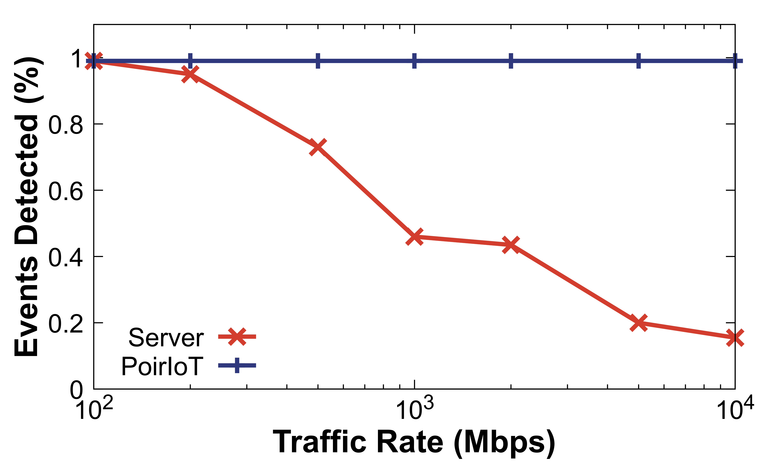
Server Vs Switch
Server drops packets at high rates and misses events
Switch operates at line rate so no degradation as rates increase
39

Slide 40
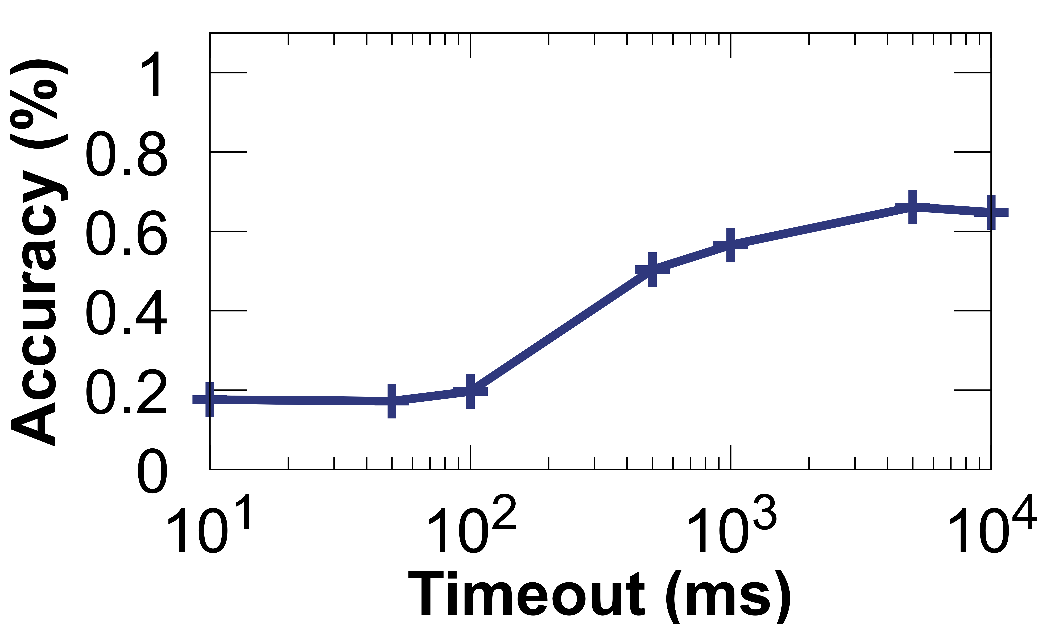
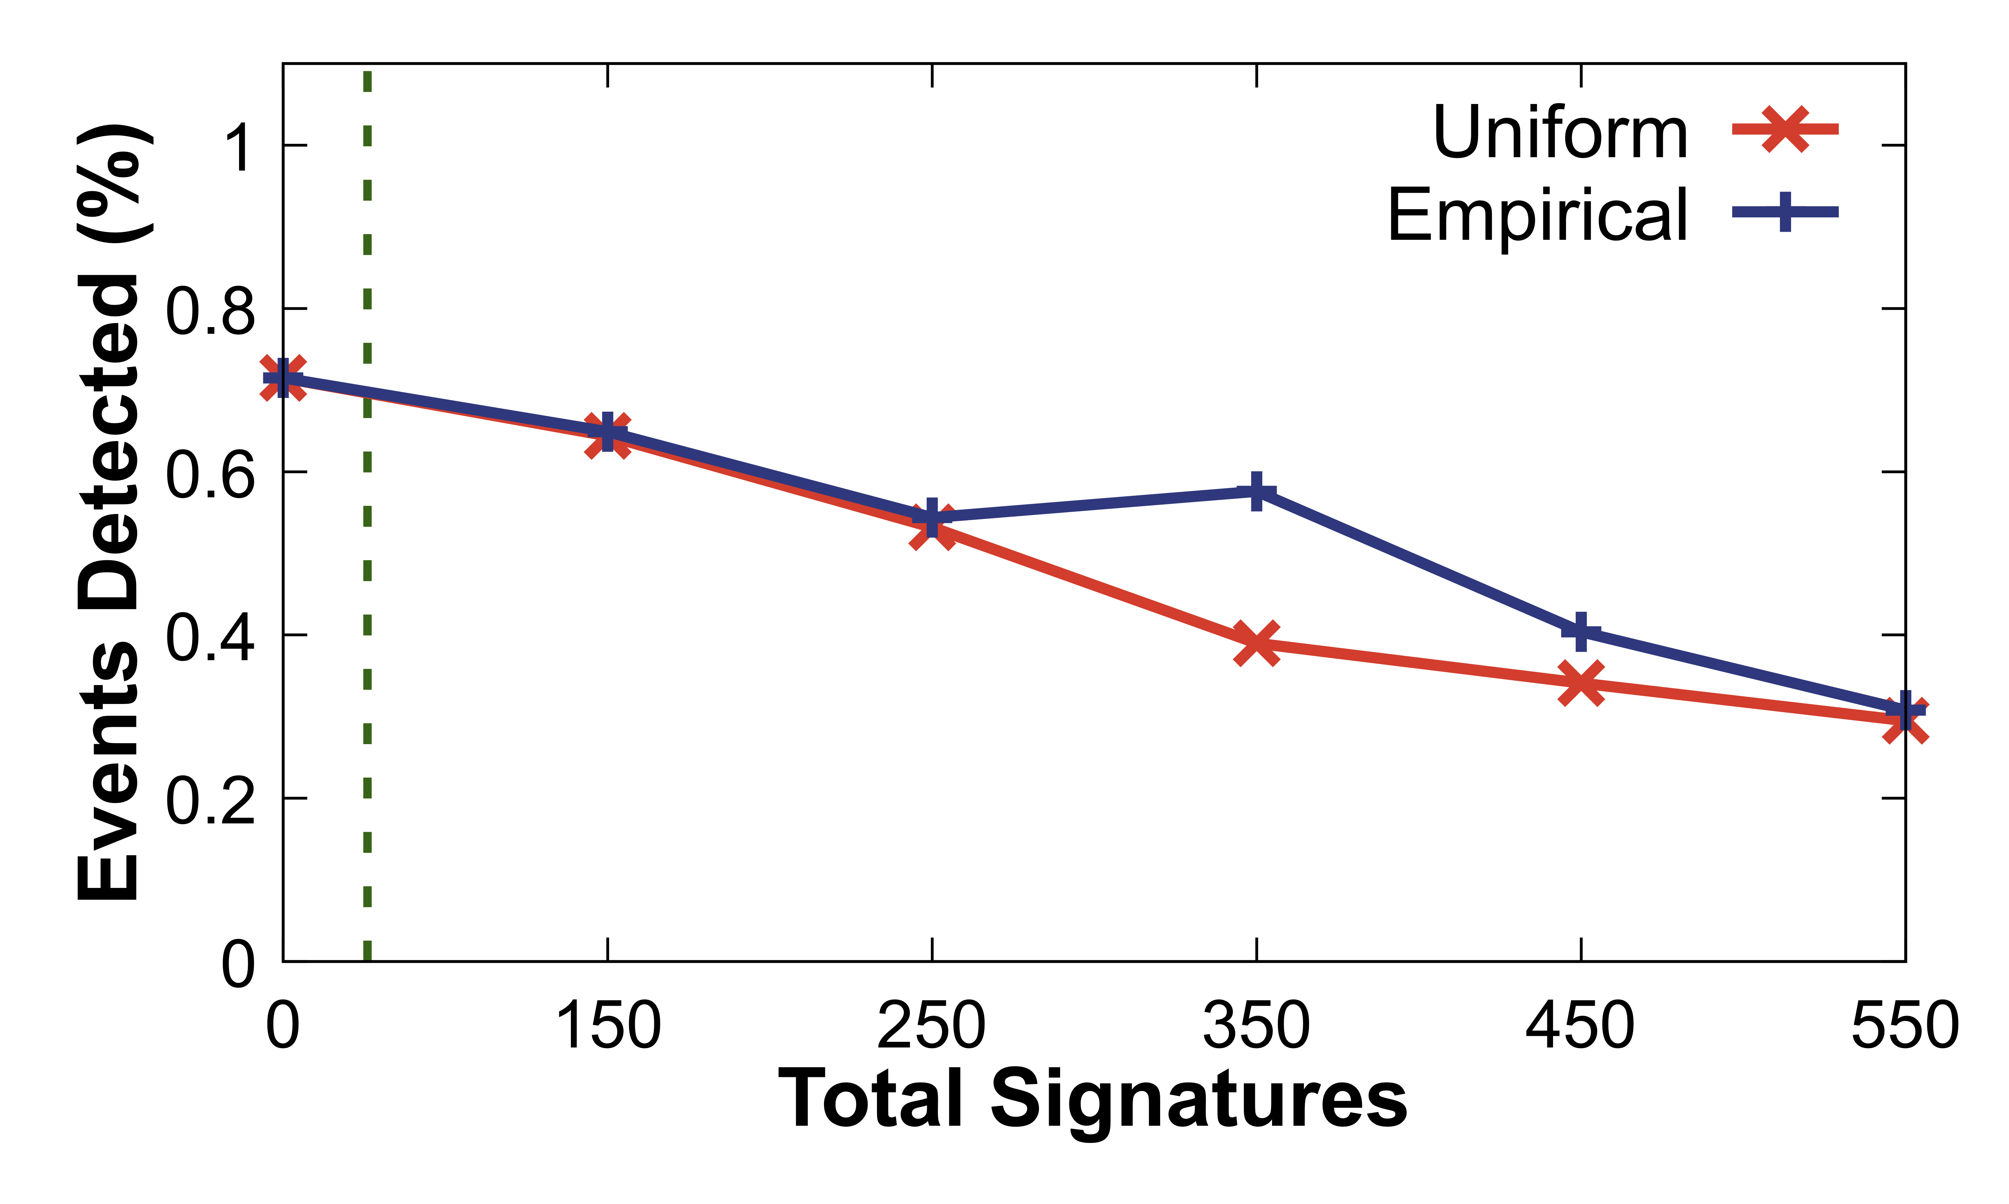
Event Detection
Event accuracy starts to decrease at longer timeouts because of a lack of resets
Event detection more granular so suffers more as signatures are added
40

